Slide 1

Quick Intro to Machine Learning
whetting your appetite for some robot intelligence
By: Juan David Osorio
Smart robot by: https://www.coursera.org/course/ml

Slide 2


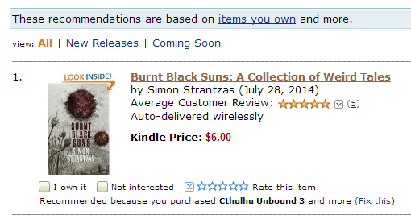


http://www.amazon.com/gp/yourstore/recs/

Slide 3
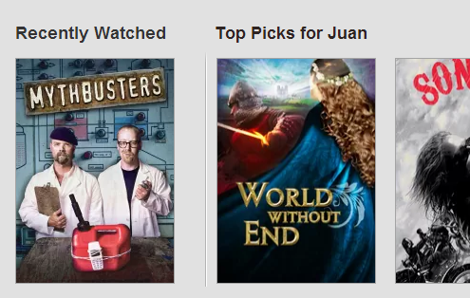

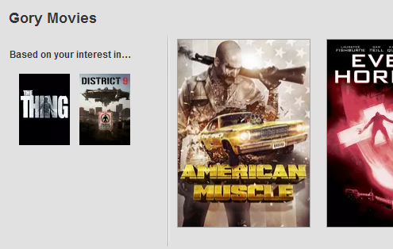
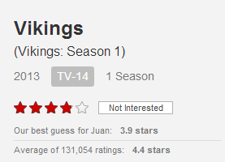
http://www.netflix.com/

Slide 4
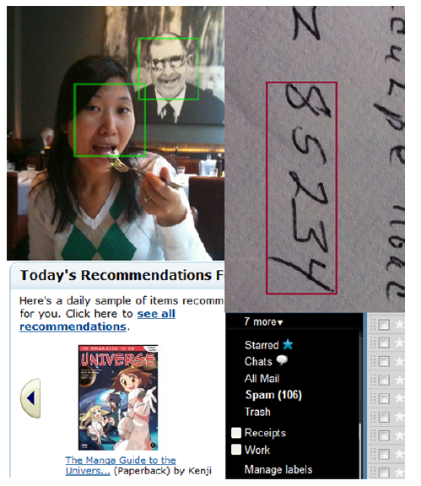
Peter Harrington. 2012. Machine Learning in Action. Manning Publications Co., Greenwich, CT, USA.

Slide 5
Machine Learning
"A computer program is said to learn from experience E with respect to some class of tasks T and performance measure P, if its performance at tasks in T, as measured by P, improves with experience E" (1)
1. Tom M. Mitchell (1997). Machine Learning, McGraw Hill

Slide 6
Machine Learning
“Machine learning algorithms can figure out how to perform important tasks by generalizing from examples” (1)
The essence of machine learning (2):
A pattern exists.
We cannot pin it down mathematically.
We have data on it.
Pedro Domingos. “A Few Useful Things to Know About Machine Learning”
Yaser S. Abu-Mostafa. "Learning From Data. Lecture 1 "

Slide 7
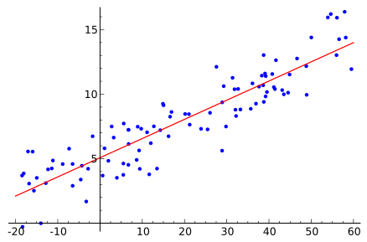
A classic example: Linear Regression
Wikipedia. Linear Regression

Slide 8
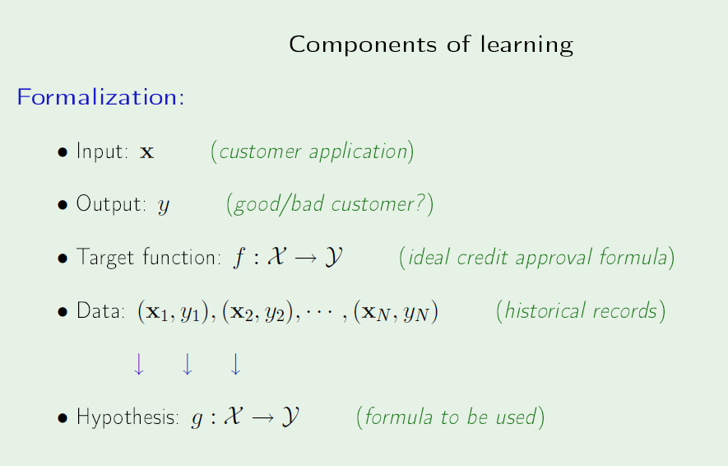
Yaser S. Abu-Mostafa. "Learning From Data. Lecture 1 "

Slide 9
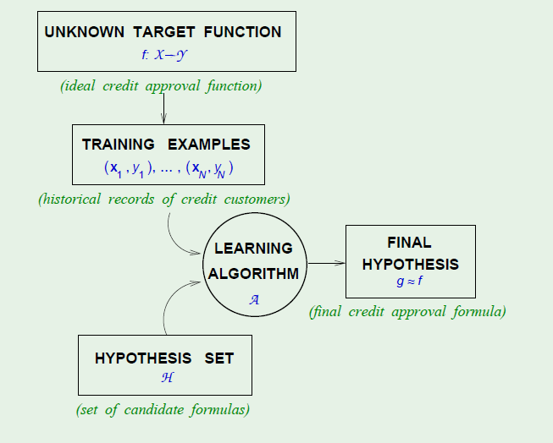
Yaser S. Abu-Mostafa. "Learning From Data. Lecture 1 "

Slide 10

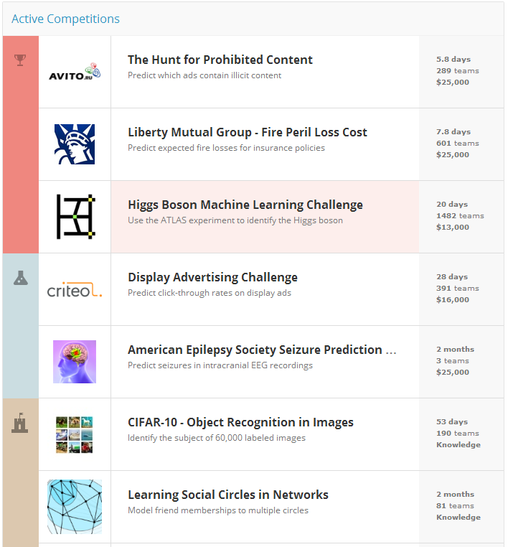
http://www.kaggle.com/

Slide 11


